Slide 1

BUAN 6346 Big Data Risk Factor Analysis - Project
Group 2
Mihir Bansal
Samipya Nanavati
Oleksandr Protsko
Alankrita Roy
Sujeeth Shetty
Madanagopal Srinivasan
Vijit Bipin Vengsarkar

Slide 2
Problem Statements and Objectives
Identify dangerous commercial truck drivers nationwide using risk factor.
Data Ingestion [Sqoop] , Data Processing [Impala, Hive] , Data Analysis[R], Data Visualization[Tableau].
Create analytics reports and a visual presentation that will provide information to a fleet manager about risk factor for all drivers.

Slide 3





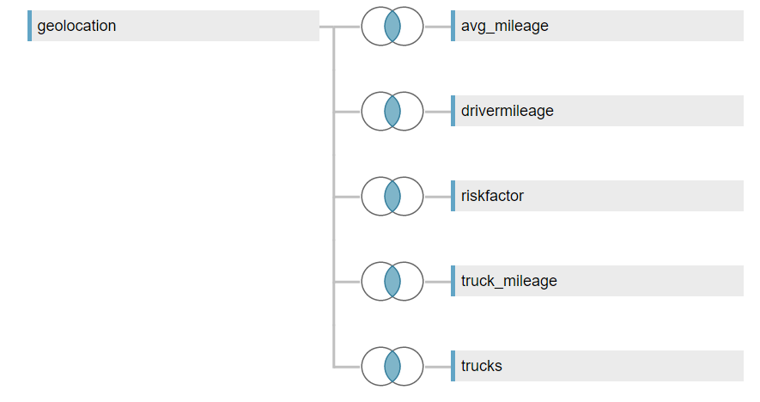


Project Workflow
Hadoop (HDFS) was used to store the data which was later used for processing and visualization
Input data
Sqoop was used to ingest data into Impala/Hive tables
geolocation.csv
We used Tableau to visualize the data and answer important questions.
trucks.csv
Raw csv data
Impala and Hive were used to create tables, process and understand the data.
Impala was preferred as it is faster than Hive.
Pig was used to process columns in a table and populate the newly generated columns in another table.
We used R to build forecasting models using Logistic regression

Slide 4
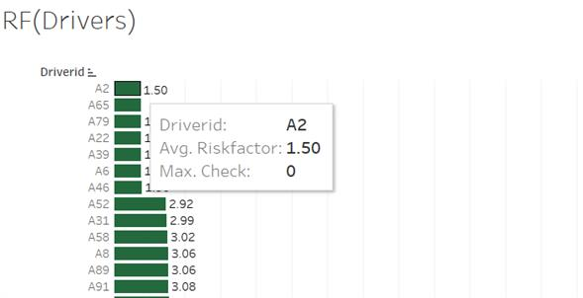
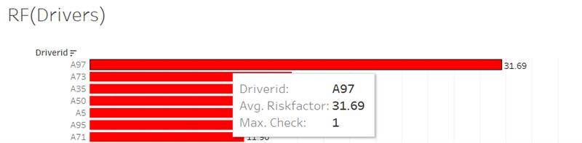
Tableau Visualisation
As shown in the screenshot, the one in green shows the least risky driver with ID as A2 and risk factor as 1.50
The red one shows the riskiest driver with ID as A97 and risk factor as 31.69

Slide 5
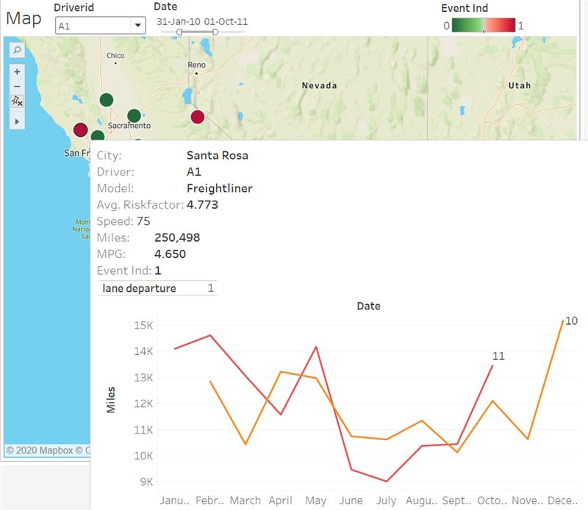
This visualization gives the detail information about risk level for a driver by destinations. This visualization can be used for one driver or for the entire fleet. As shown here, it also provides details about the gas consumption and mileage dynamic by date. The event information is also displayed which helps in determining the problematic locations for the fleet.

Slide 6
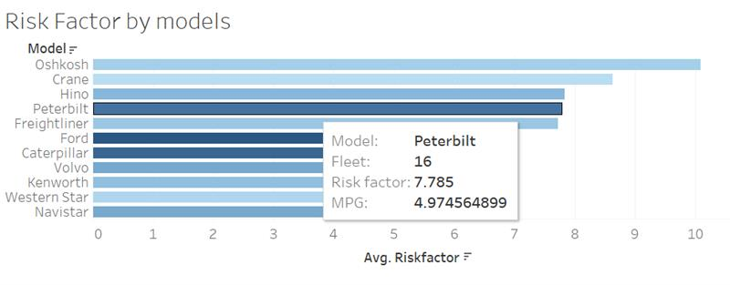
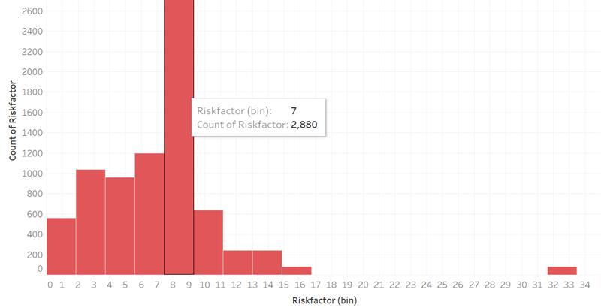
Histogram Representation of Risk Factor

Slide 7
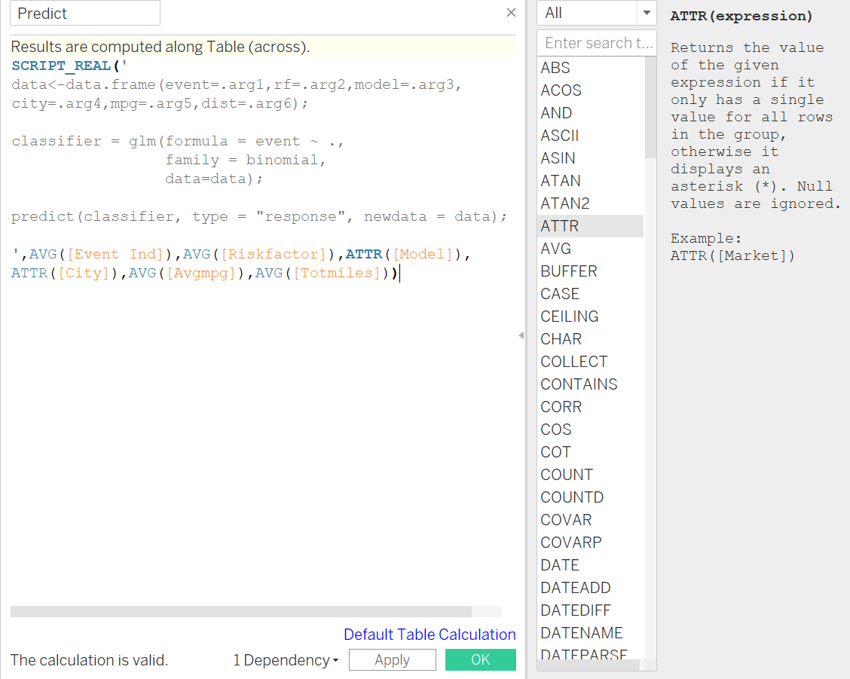
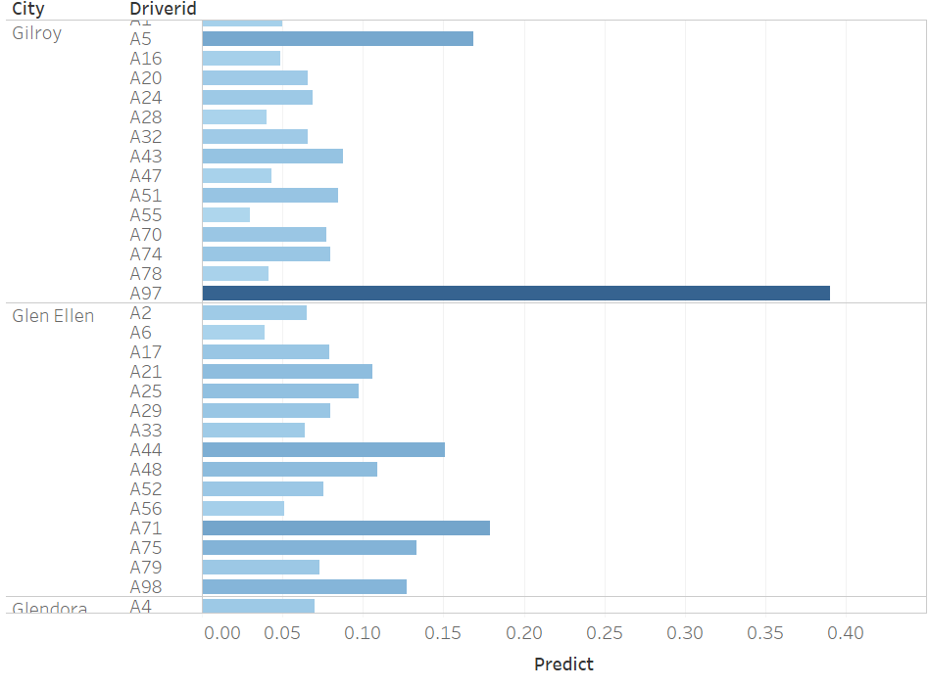
Logistic Regression
Integrated R script (Logit model) in Tableau to predict risk of event for a selected city.
This tool helps fleet manager in planning routes by providing information based on driver’s risk profile.

Slide 8
Thank You

